Slide 1
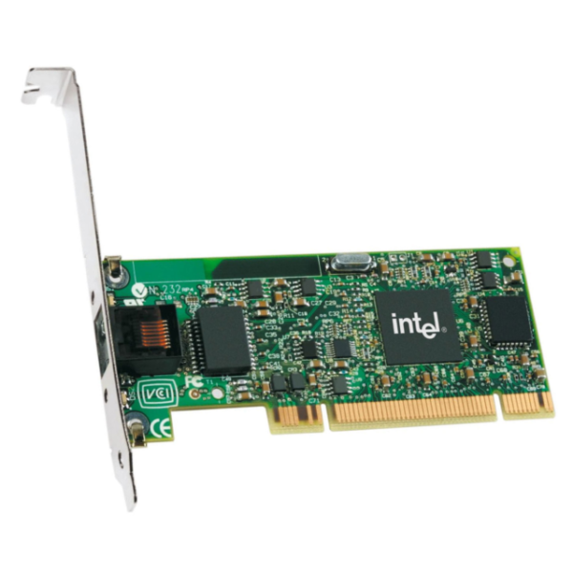

Slide 2
Network Filters
Web Interface
Network Adapter + Serial Port + Disk Drive + Power Control

Slide 3
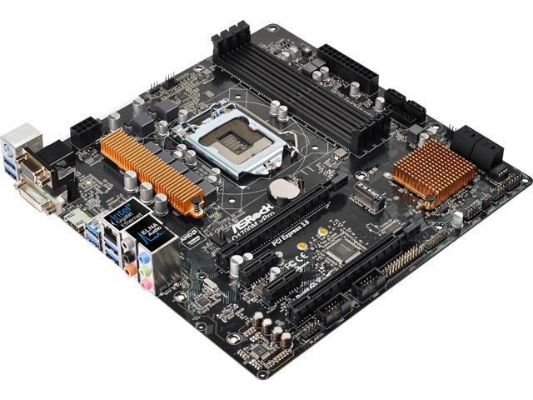
Intel® ME
Located in here

Slide 4
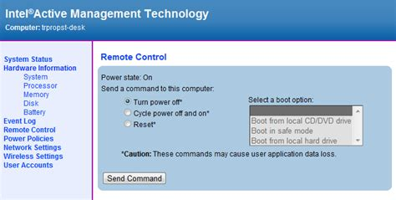
Intel AMT 1.0+
TCP Port 16992 or 16993

Slide 5
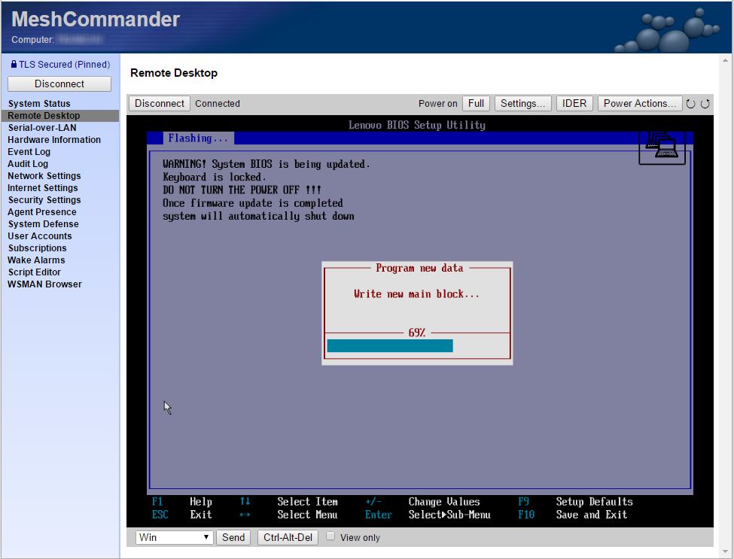
Intel AMT 1.0+
Serial-over-LAN

Slide 6

Intel AMT 4.0+
Client Initiated Remote Access (CIRA)

Slide 7
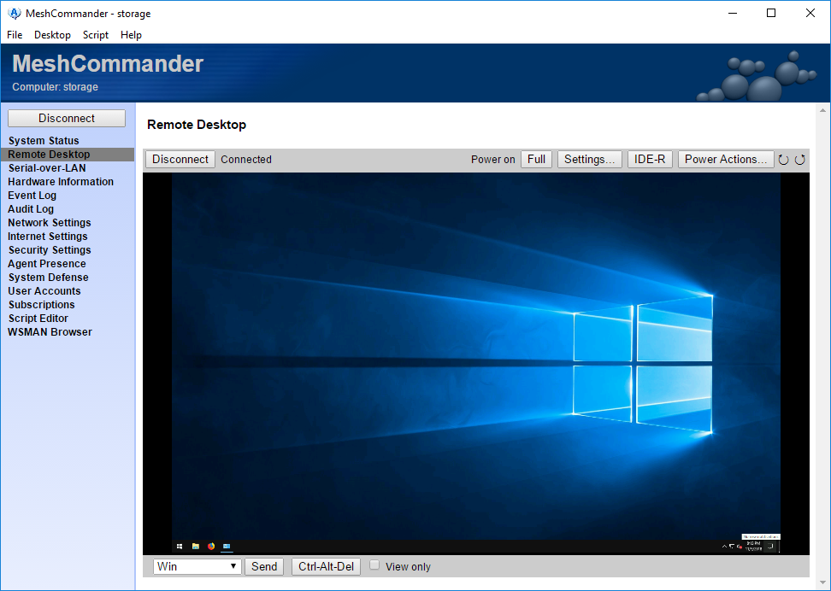
Intel AMT 6.0+
KVM

Slide 8
Intel AMT 6.1+
ACM - Admin Control Mode
CCM – Client Control Mode

